Slide 1
Writing An Effective Position Description
Division of Human Resources, Employee Diversity, and Wellness
Kim Sipes, Employment and Classification/Compensation Manager
and
Scott Hoffmann, Classification and Compensation Specialist

Slide 2
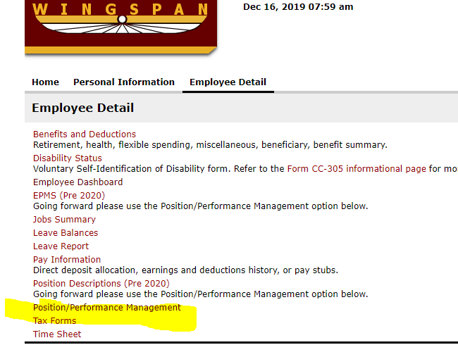
Accessing a Position Description in the new Position Management Module
STEP 1: Sign in through Wingspan and select Position/Performance Management
Log in in Wingspan Under
Or by
Using: https://winthrop.peopleadmin.com/hr/

Slide 3
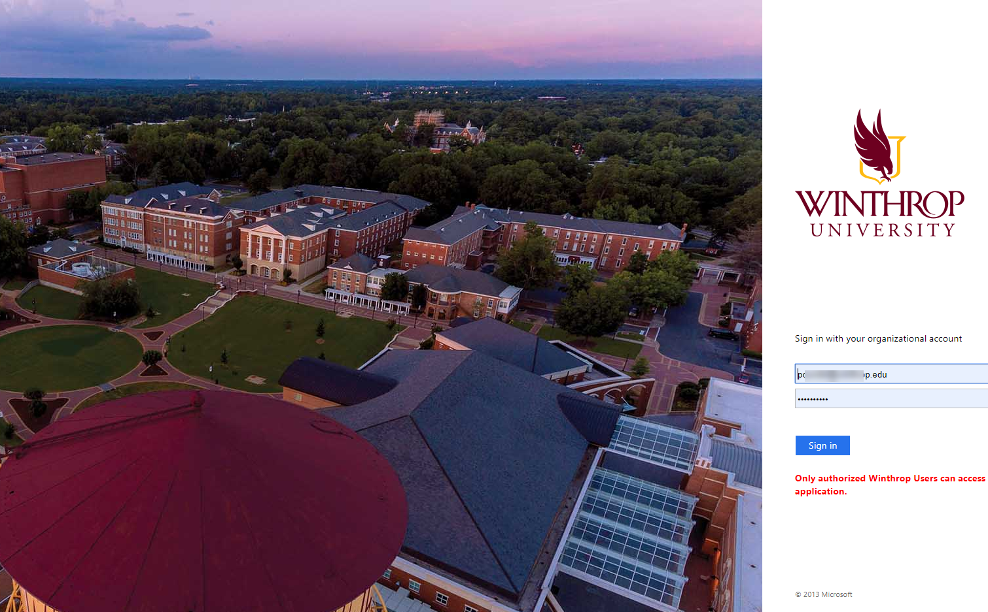
Accessing a Position Description in the new Position Management Module
You may have to sign in a second time with your WIN Account credentials (add Winthrop.edu)

Slide 4
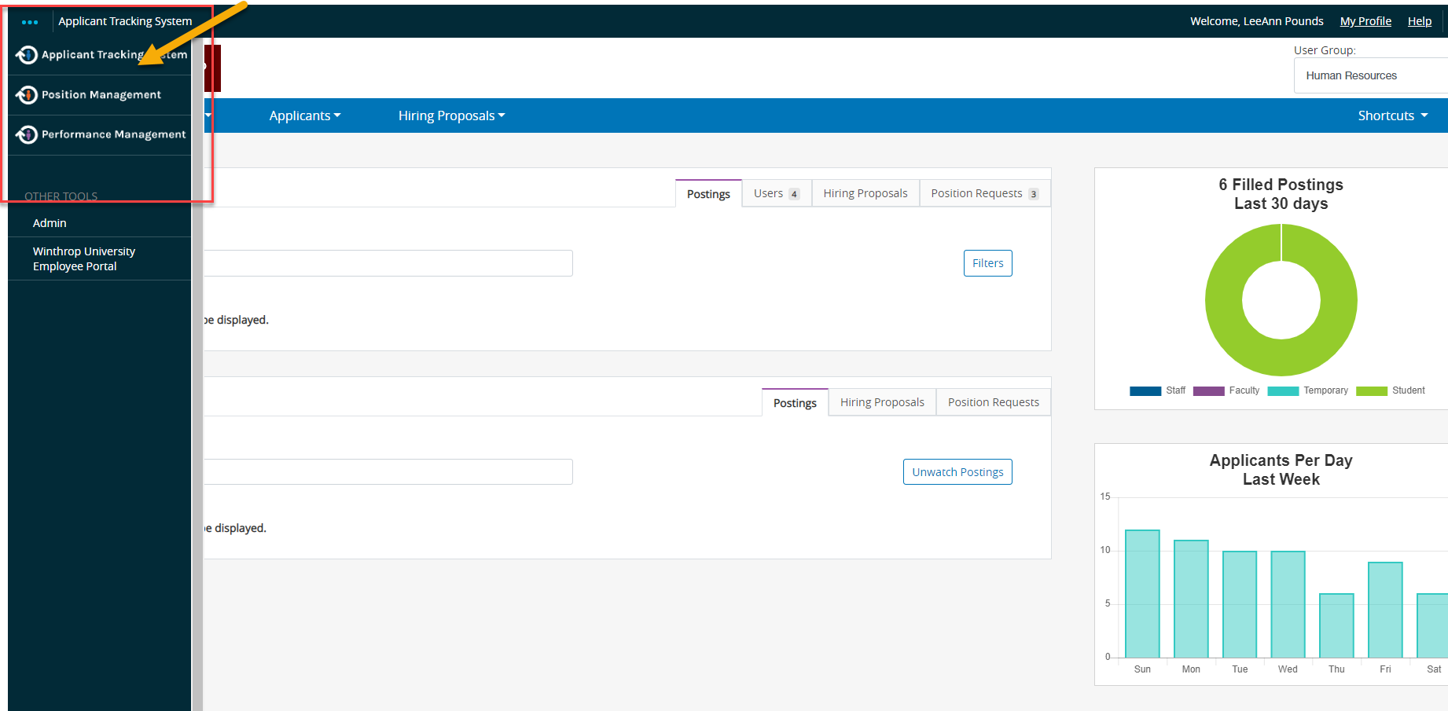
Accessing a Position Description in the new Position Management Module
Go to the top left corner of the PeopleAdmin home page to the Blue ellipsis.
Then, on the pulldown screen, select “Position Management.”

Slide 5
Position Description Overview
A well-written position description clearly, concisely and accurately documents a position’s
duties and responsibilities,
supervisory relationships,
required and preferred education, training, experience, knowledge, skills and abilities, and
physical requirements and working conditions.

Slide 6
Importance of the Position Description
Serves as the basis for the recruitment and selection process.
Sets guidelines and expectations for the employee.
Serves as the basis for the performance evaluation.
Establishes data for comparison and classification purposes.
Helps to ensure “equal pay for equal work.”
Used to determine FLSA status (exempt vs. non-exempt).
Going forward, all position descriptions will be created and revised through the new Position Management module and will serve as the basis for posting staff positions—classified and unclassified—as well as all temporary positions recruited through HR.

Slide 7
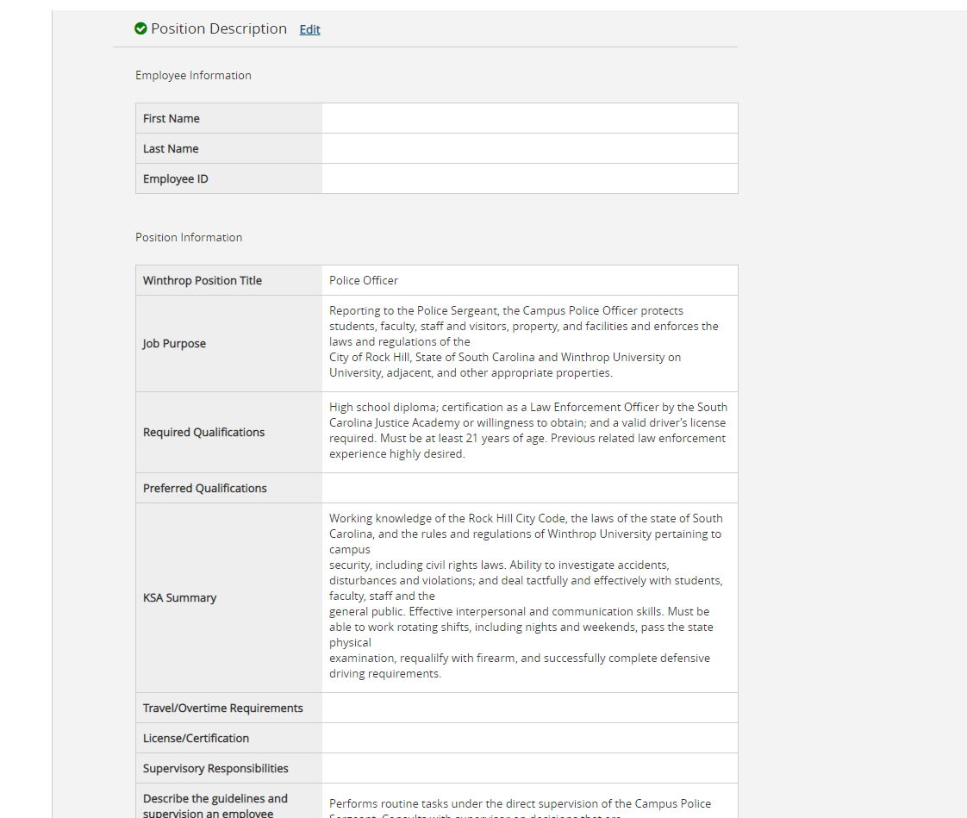
New Format

Slide 8
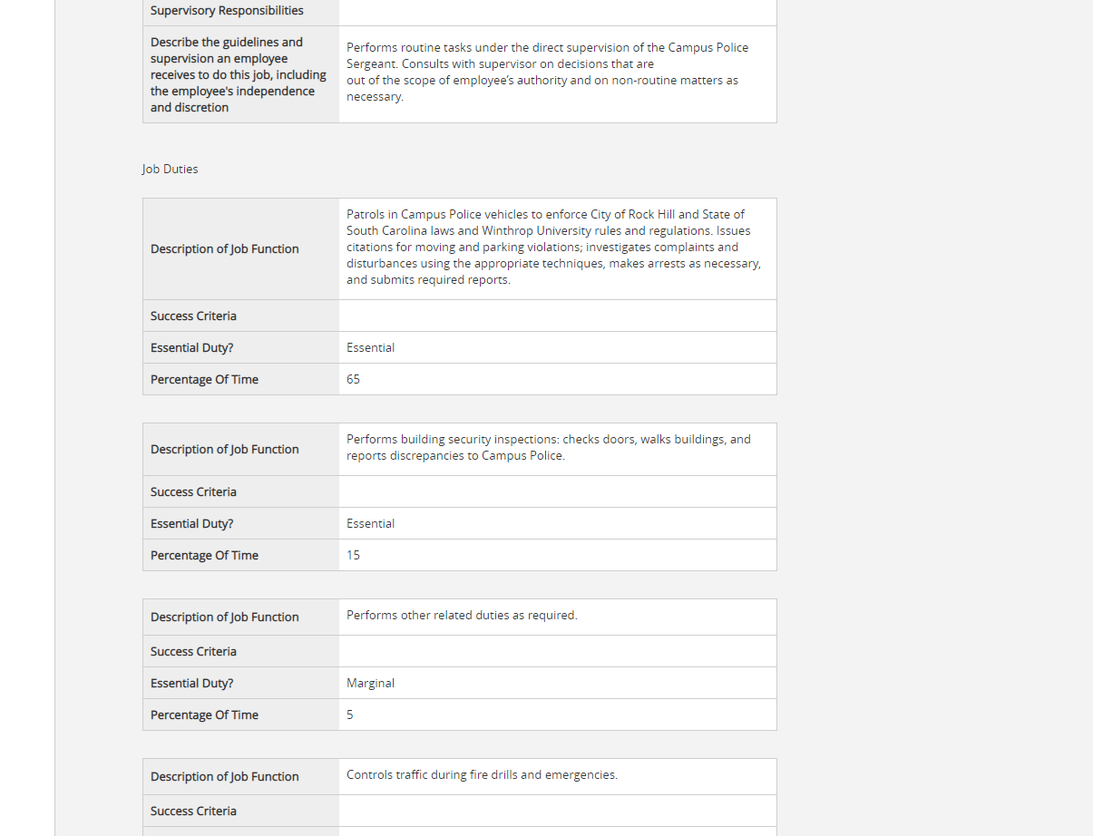
New Format

Slide 9
Job Purpose Statement
The Job Purpose typically is one or two concise sentences that capture the reason the position exists and its objectives.
Example: Reporting to the Employee Relations and Benefits Manager, the Senior Benefits Administrator manages all communications and compliance activities related to Winthrop’s comprehensive employee benefits program.

Slide 10
Job Duties
The Job Duties section is the cornerstone of the Job Description and the basis for determining a position’s classification within the South Carolina state system.
It delineates the essential and other duties and responsibilities necessary to achieve the stated Job Purpose.
When drafting Job Duty statements:
Begin each statement with an action verb.
Do not include duties that may be required in the future.
Write the job duties (and other sections) based on what the position requires, not the capabilities of a particular employee.
If you are unsure about the percentage of time devoted to a particular function, check with the employee.

Slide 11
Job Duties
A good statement of job duties addresses one or more of the following questions:
What is being done?
Why is it being done?
How is it being done? (Indicates the methods/techniques used to perform the work.)
Who or what is the action/activity helping, supporting or targeting?
Example: Provides excellent customer service to members of the campus community by responding to phone calls and emails within 24 hours of receipt.

Slide 12
Job Duties
Suggested method for developing Job Duty statements:
Develop a list of primary responsibilities/functions (typically three to five).
Generate specific job duties associated with each responsibility/function.
Example:
Primary Responsibility: Serves as point of contact for the Office of Human Resources.
Job Duties: Greets customers, routes phone calls, and schedules meetings.
Job Duties Statement: Serves as the point of contact for the Office of Human Resources: greets customers, routes phone calls, and schedules meetings for benefits administrators.

Slide 13
Job Duties
Job Duty percentages should be between 5% and 45% in increments of five. If a duty/function constitutes greater than 45% of the position, be sure to break down the percentages within the paragraph of duties.
Example: E - 60%
Conducts research and related activities to produce employee data and compensation reports required for annual, quarterly, monthly and daily reporting; provides ad hoc reporting to executive management; direct report to the President for projects/programs that have a campuswide impact on employees; accountable to the President for the above also for annual reporting of information as required by the General Appropriations Act and SC Code of Laws (45%).
Develops, implements and manages the University's employee-related data for all active/inactive employee-related records, audits and data regarding employment, classification, compensation, benefits, training/performance, retirement, EEO/AA, and employee relations information (15%).

Slide 14
What Are Essential Functions?
The Americans with Disabilities Act (ADA) of 1992 encouraged employers to identify the essential duties of a position to help determine whether reasonable accommodations could be made.
South Carolina agencies achieve this goal by identifying job duties as essential or marginal.
Essential job duties must meet one or more of the following criteria:
The job duty/function is one of the reasons the position exists.
A limited number of employees are available to perform the function.
The function is highly specialized.

Slide 15
Success Criteria
Success criteria tell an employee the level of performance a supervisor expects.
They are needed for each job function and should be: 1) measurable 2) objective 3) attainable and 4) reflect the level of skill required to be successful in the position.
Measurable criteria include:
Time (e.g. completing a function by a certain date),
Quality (absence of error or variation),
Frequency of occurrence (performing a task daily, weekly, etc.),
Productivity counts (processing a certain number of items per week, for example), and/or
Cost (e.g. organizing an event within a specified budget).

Slide 16
Success Criteria
Example
Job Duty: Recruiting: Maintains the recruiting spreadsheets; creates search files; uses updated position descriptions to create job vacancy notices (JVNs) and screening questions; and posts jobs on NeoGov and the HR bulletin board.
Success Criteria:
Updates the recruiting spreadsheet daily.
Ensures JVNs contain all necessary employment-related information, are in the approved format, and are error-free prior to posting.
Posts positions as soon as hiring supervisor approves the JVN and screening questions (the next morning if approval received after 4 p.m.).

Slide 17
Minimum Requirements/Qualifications
The State has established minimum education, training and experience guidelines for each job classification. These guidelines are intentionally generic and broad because they apply to ALL jobs assigned to a specific classification.
State agencies may set minimum requirements that are more stringent than the state’s minimum requirements but not less stringent.
Exception: South Carolina state colleges and universities have delegated authority to determine equivalency requirements. For example, if a job posting requires a bachelor’s degree and two years of experience, but a candidate possesses an associate’s degree and 10 years of experience, HR may be able to approve an equivalency so that the candidate can be considered for hire. All equivalencies must be approved by HR before an applicant can be considered.

Slide 18
Preferred Qualifications
Preferred qualifications include the education, training and/or experience that would be ideal but not necessary in order for someone to be successful in a position.
Typically, applicants who possess the preferred qualifications are placed in Pool A for screening purposes.
Examples:
1. Experience in a higher education environment preferred.
2. Proficiency with Microsoft Office highly desired.
3. Master’s degree preferred.

Slide 19
Knowledge, Skills and Abilities
A position description also delineates the knowledge, skills and abilities (KSAs) needed to perform a job successfully.
Knowledge: A body of information necessary for successful performance. May be gained through formal education, training and/or experience.
Skills: An observable, often learned, competence. May imply a level of proficiency. Example: Proven written communication skills.
Abilities: Natural tendencies, talents and strengths that allow someone to perform a function/observable behavior. Example: Ability to develop and maintain effective working relationships with faculty, staff, students and the general public.

Slide 20
Knowledge, Skills and Abilities
It is important to note that KSAs must be realistic and clearly related to a position’s responsibilities and duties.
For example, if the KSA section includes the ability to read and comprehend complex material, the position description must include a job function that requires that ability for success.

Slide 21
Guidelines and Supervision
The position description also outlines the guidelines and level of supervision an employee will receive.
Direct supervision: The employee is told what to do and how to do it and is not required to exercise independent judgment or authority. Job duties tend to be prescriptive in nature.
General supervision: The employee is told what to do but not how to do it. The “how” is left up to the employee.
Limited supervision: The employee uses his/her own creativity and/ or judgment to get the job done. The employee receives general assignments and is free to work out the details. In these positions, an employee often is expected to interpret regulations and policies within his/her defined scope of work (Job Description).

Slide 22
Questions for Setting Supervision Level
For what level of responsibility will the employee be held accountable?
How often—daily, weekly or more infrequently—is the employee’s work reviewed?
What level of decision-making does the employee have in the absence of supervision?
Are there any formal regulations, policies, etc. that must be followed in fulfilling job responsibilities?

Slide 23
ADA Checklist
Position descriptions in the new system feature an ADA checklist rather than a write-in section.
The ADA checklist includes sections on mental and physical demands; lifting and visual acuity requirements; noise conditions; and the equipment the employee must use to perform the job successfully.
The checklist is important for employees seeking accommodations under ADA. It also is important for employees on FMLA, because doctors review this section when determining an employee’s eligibility to return to work.
Be sure to review the list carefully and select only those that are essential to the position.

Slide 24
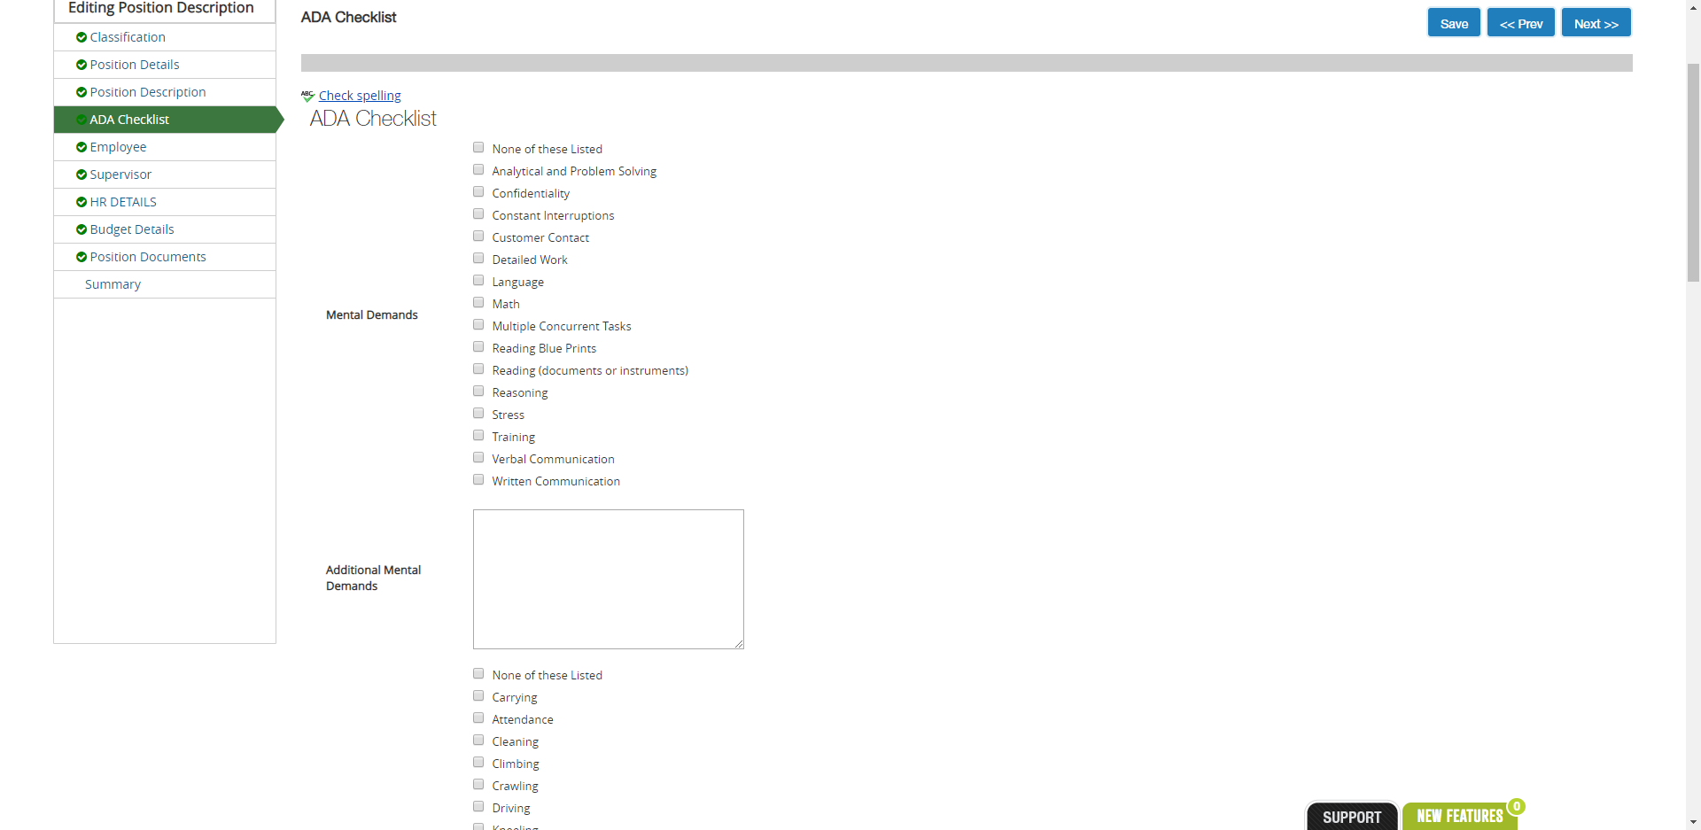
ADA Checklist

Slide 25
ADA Checklist
The end of the checklist also includes a section on Winthrop-specific systems.

Slide 26
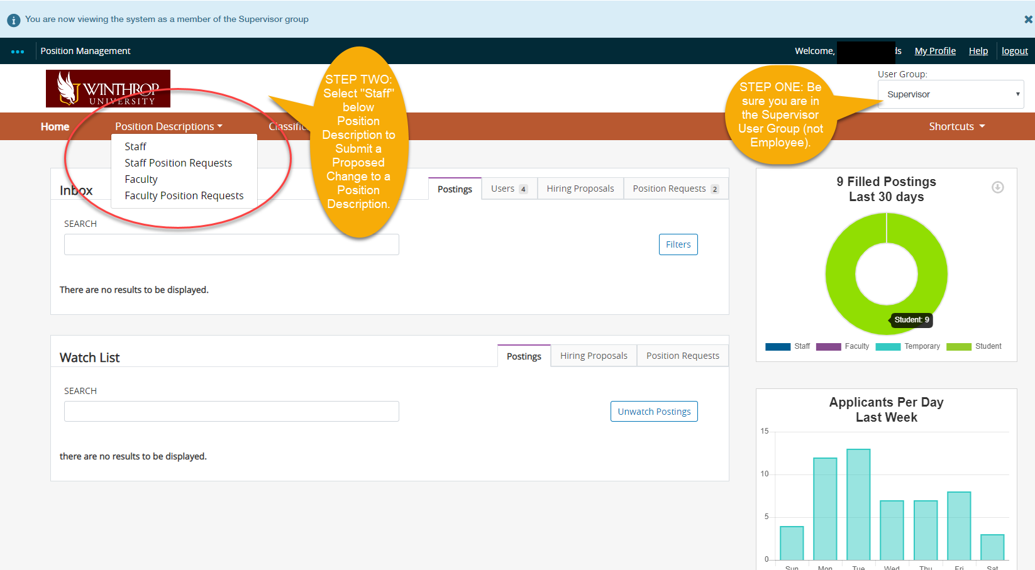
Steps to Modify a Position Description
1. Select “Supervisor” as your User Group at the top right corner.
2. Click on “Position Descriptions” in the orange bar near the top of the page and select “Staff.”

Slide 27
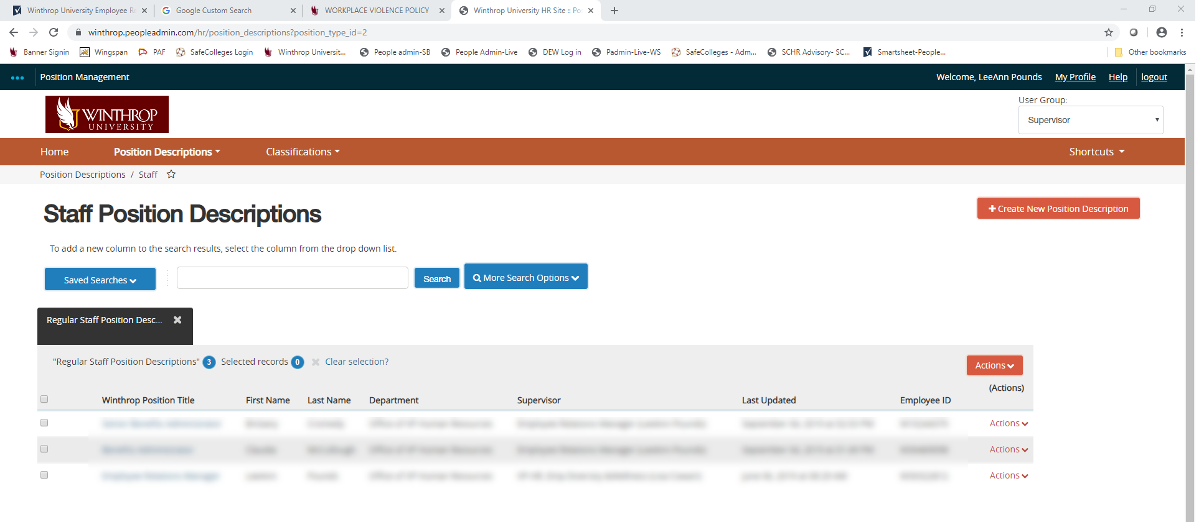
Steps to Modify a Position Description
Selecting “Staff” under “Position Descriptions” takes you to a list of all employees who report to you—both directly and indirectly
(full chain of command).

Slide 28
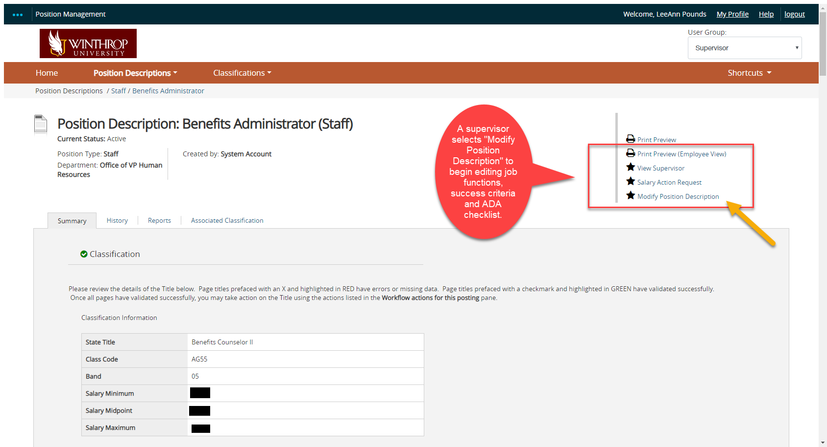
Steps to Modify a Position Description
Once you select an employee’s name from the list, you will be taken to the Position Description page, where you will need to select an action from the list on the right-hand side of the page.

Slide 29
Step-By-Step
Check the blue ellipsis at the top left of the page—it should indicate “Position Management.”
Check your User Group at the top right of the page—it should indicate “Supervisor.”
To modify a position description, click on “Position Descriptions” in the orange near the top of the page and select “Staff.” This should bring up a list that includes your position and the positions you supervise (directly and indirectly).
Click on the title of the position you want to modify and select “Modify Position” from the list of actions on the top right of the page.
Make and save your updates. Then, go to the Summary tab, click on “Take Action on Position Description,” and select “Submit (move to Initial HR Review).”
If you initiate a position description modification but don’t complete it before exiting the system, you will need to select “Staff Position Requests” rather than “Staff” under “Position Descriptions” (Step 3 above). This will take you to a list of all in-process requests for your employees. Select the position description you’d like to complete and click on “Edit” to complete the updates. (You can click on “Edit” next to the position title to open up the whole document or open up a specific section by clicking “Edit” next to the section title.)

Slide 30
Questions or Comments?
Source: Department of State Human Resources Division
Need Help?
Scott Hoffmann—Position description updates, CPA review process
Email: Hoffmanns@Winthrop.edu
Ext. 6267
Kim Sipes—Posting process/vacancy announcements
Email: sipesk@winthrop.edu
Ext. 2278
LeeAnn Pounds—Performance management reviews
Email: poundsl@winthrop.edu
Ext. 6255

